Slide 1
Model-View-Controller
Engineering Software as a Service §2.5
© 2013 Armando Fox & David Patterson, all rights reserved
Notes:
earliest ever lecture prep! aug 4
follow along download slides

Slide 2
Whither Frameworks?
Is there common application structure…
in interactive user-facing apps…
…that could simplify app development if we captured them in a framework?

Slide 3
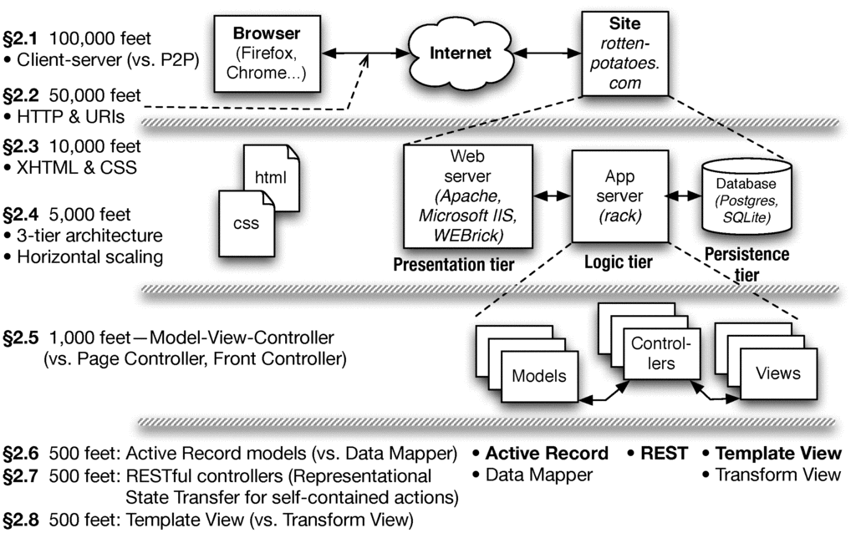
Chapter 2 Overview

Slide 4
The MVC Design Pattern
Goal: separate organization of data (model) from UI & presentation (view) by introducing controller
mediates user actions requesting access to data
presents data for rendering by the view
Web apps may seem “obviously” MVC by design, but other alternatives are possible...
• Read data
• Update data
• User actions
• Directives for rendering data
Controller
View
Model
• Data provided to views through controller

Slide 5

Each Entity Has a Model, Controller, & Set of Views
Movies
Controller
Movie
Moviegoers
Controller
Reviews
Controller
Moviegoer
Review

Slide 6
Alternatives to MVC
Page Controller
(Ruby Sinatra)
Front Controller
(J2EE servlet)
Template View (PHP)
models
models
models
page A
A
app
views
page B
B
views
page C
C
Rails supports SaaS apps structured as MVC, but other architectures may be better fit for some apps.

Slide 7
END

Slide 8
Which statement is NOT true about the Model-View-Controller (MVC) architectural pattern:
☐
In SaaS apps on the Web, controller actions and view contents are transmitted using HTTP.
All MVC apps have both a “client” part (e.g. Web browser) and a “cloud” part (e.g. Rails app on cloud).
☐
☐
Model-View-Controller is just one of several possible ways to structure a SaaS app.
☐
Peer-to-peer apps (vs. client-server apps) can be structured as Model-View-Controller.
Notes:
True.
False. An MVC app could all be running on same machine.
True.
True. Peers can each have MVC pattern, peers access each other via view.

Slide 9
END

Slide 10
Models, Databases, and Active Record
Engineering Software as a Service §2.6
© 2013 Armando Fox & David Patterson, all rights reserved
Notes:
earliest ever lecture prep! aug 4
follow along download slides

Slide 11
Data Storage
How should we store and retrieve record-oriented structured data?
What is the relationship between data as stored and data as manipulated in a programming language?

Slide 12
Chapter 2 Overview

Slide 13
In-Memory vs. In-Storage Objects
#<Movie:0x1295580>
m.name, m.rating, ...
marshal/serialize
?
#<Movie:0x32ffe416>
m.name, m.rating, ...
unmarshal/deserialize
How to represent persisted object in storage
Example: Movie with name & rating attributes
Basic operations on object: CRUD (Create, Read, Update, Delete)
ActiveRecord: every model knows how to CRUD itself, using common mechanisms

Slide 14
Rails Models Store Data in Relational Databases (RDBMS)
Each type of model gets its own database table
All rows in table have identical structure
one row in table == one instance of model’s class
Each column stores value of an attribute of the model
Each row has unique value for primary key (by convention, in Rails this is an integer and is called id)
Schema: Collection of all tables and their structure
id | rating | title | release_date
2 | G | Gone With the Wind | 1939-12-15
11 | PG | Casablanca | 1942-11-26
... | ... | ... | ...
35 | PG | Star Wars | 1977-05-25

Slide 15
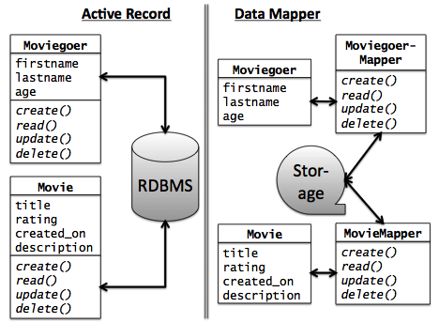
Alternative: DataMapper
Data Mapper associates separate mapper with each model
Idea: keep mapping independent of particular data store used => works with more types of databases
Used by Google AppEngine
Con: can’t exploit RDBMS features to simplify complex queries & relationships
We’ll revisit when talking about associations

Slide 16
END

Slide 17
Which statement is not true about the Model in Model-View-Controller:
☐
The CRUD actions only apply to models backed by a database that supports ActiveRecord.
☐
Part of the Model’s job is to convert between in-memory and stored representations of objects.
☐
Although Model data is displayed by the View, a Models’ direct interaction is with Controllers.
☐
Although DataMapper doesn’t use relational databases, it’s a valid way to implement a Model.
Notes:
False. CRUD applies to all data models.
True.
True.
True.

Slide 18
END

Slide 19
Administrivia
Who Is Not On a Project Team?
Which Teams Do Not Have 5-6 Members?
Quiz 1
Thu 2/5
Covers Chapters 1 and 2
15 minutes, starts exactly at start of class!

Slide 20
END

Slide 21
Controllers, Routes, and RESTfulness
Engineering Software as a Service §2.7
© 2013 Armando Fox & David Patterson, all rights reserved
Notes:
earliest ever lecture prep! aug 4
follow along download slides

Slide 22
Design for SOA
What design decisions would allow our app to support Service-Oriented Architecture?

Slide 23
Chapter 2 Overview

Slide 24
REST (Representational State Transfer) - R. Fielding, 2000
Idea: URI names resource, not page or action
Self-contained: which resource, and what to do to it
Responses include hyperlinks to discover additional RESTful resources
“a post hoc [after the fact] description of the features that made the Web successful”
A service (in the SOA sense) whose operations are like this is a RESTful service
Ideally, RESTful URIs name the operations

Slide 25
Routes
In MVC, each interaction the user can do is handled by a controller action
Ruby method that handles that interaction
A route maps <HTTP method, URI> to controller action
Route | Action
GET /movies/3 | Show info about movie whose ID=3
POST /movies | Create new movie from attached form data
PUT /movies/5 | Update movie ID 5 from attached form data
DELETE /movies/5 | Delete movie whose ID=5

Slide 26
Brief Intro to Rails’ Routing Subsystem
dispatch <method,URI> to correct controller action
provides helper methods that generate a <method,URI> pair given a controller action
parses query parameters from both URI and form submission into a convenient hash
Built-in shortcuts to generate all CRUD routes (though most apps will also have other routes)
rake routes
I GET /movies {:action=>"index", :controller=>"movies"}
C POST /movies {:action=>"create", :controller=>"movies"}
GET /movies/new {:action=>"new", :controller=>"movies"}
GET /movies/:id/edit {:action=>"edit", :controller=>"movies"}
R GET /movies/:id {:action=>"show", :controller=>"movies"}
U PUT /movies/:id {:action=>"update", :controller=>"movies"}
D DELETE /movies/:id {:action=>"destroy", :controller=>"movies"}
Notes:
Most apps will have routes
Rake is Ruby make command

Slide 27
GET /movies/3/edit HTTP/1.0
Matches route:
GET /movies/:id/edit {:action=>"edit", :controller=>"movies"}
Parse wildcard parameters: params[:id] = "3"
Dispatch to edit method in movies_controller.rb
To include a URI in generated view that will submit the form to the update controller action with params[:id]==3, call helper: update_movie_path(3) # => PUT /movies/3
rake routes
I GET /movies {:action=>"index", :controller=>"movies"}
C POST /movies {:action=>"create", :controller=>"movies"}
GET /movies/new {:action=>"new", :controller=>"movies"}
GET /movies/:id/edit {:action=>"edit", :controller=>"movies"}
R GET /movies/:id {:action=>"show", :controller=>"movies"}
U PUT /movies/:id {:action=>"update", :controller=>"movies"}
D DELETE /movies/:id {:action=>"destroy", :controller=>"movies"}

Slide 28
END

Slide 29
Which statement is NOT true regarding Rails RESTful routes and the resources to which they refer:
☐
A resource may be existing content or a request to modify something.
☐
In an MVC app, every route must eventually trigger a controller action.
☐
One common set of RESTful actions is the CRUD actions on models.
☐
The route always contains one or more "wildcard" parameters, such as :id, to identify the particular resource instance in the operation
Notes:
True.
True.
True.
False. Example: “GET /movies”

Slide 30
END

Slide 31
Template Views and Haml
Engineering Software as a Service §2.8
© 2013 Armando Fox & David Patterson, all rights reserved

Slide 32
HTML Generation
HTML is how we must present content to browsers…
…but what is the process by which our app’s output becomes HTML?

Slide 33
Chapter 2 Overview

Slide 34
Template View Pattern
View consists of markup with selected interpolation to happen at runtime
Usually, values of variables or result of evaluating short bits of code
In the past, this was the app (e.g. PHP)
Alternative: Transform View
Haml
Closure
XML
Closure
Renderer (Action-View)
Renderer (Action-View)
HTML
Movie
JSON
erb
Movie
Movie

Slide 35
Haml is HTML on a Diet
%h1.pagename All Movies
%table#movies
%thead
%tr
%th Movie Title
%th Release Date
%th More Info
%tbody
- @movies.each do |movie|
%tr
%td= movie.title
%td= movie.release_date
%td= link_to "More on #{movie.title}", | movie_path(movie) |
= link_to 'Add new movie', new_movie_path
Notes:
no open/close tags: use indentation
tag entirely on single line, or use indentation to indicate nesting
how to specify ID & class
code that is executed but NOT substituted
note lack of 'end' for 'do': implied by indentation
code that is executed and substituted
multi-line – deliberately awkward

Slide 36
Don’t Put Code in Your Views
Syntactically, you can put any code in view
But MVC advocates thin views & controllers
Haml makes deliberately awkward to put in lots of code
Helpers (methods that “prettify” objects for including in views) have their own place in Rails app
Alternative to Haml: html.erb (Embedded Ruby) templates, look more like PHP

Slide 37
END

Slide 38
What happens if you embed code in your Rails views that tries to directly access the model (in the database)?
☐
It will work, but it’s bad form and violates the MVC guidelines
☐
It will work when developing against a “toy” database, but not in production
☐
It won’t work, because Views can’t communicate directly with Models
☐
Behavior varies depending on the app
Notes:
False.
False.
True. Routes will only specify the controller and action (method) in that controller.
False.

Slide 39
END

Slide 40
Summary & Reflections: SaaS Architecture (Engineering Software as a Service §2.9-2.10)
© 2013 Armando Fox & David Patterson, all rights reserved
Notes:
earliest ever lecture prep! aug 4
follow along download slides

Slide 41
The Big Picture (Technologies)
• URI’s, HTTP, TCP/IP stack
• REST & RESTful routes
Controller
View
Model
• Databases & migrations
• CRUD
• HTML & CSS
• XML & XPath
Notes:
NOTE: Rails doesn't appear anywhere on this slide!!

Slide 42
c. 2008: “Rails doesn’t scale”
Scalability is an architectural concern - not confined to language or framework
The stateless tiers of 3-tier arch do scale
With cloud computing, just worry about constants
Traditional relational databases do not scale
Various solutions combining relational and non-relational storage (“NoSQL”) scale much better
DataMapper works well with some of them
Intelligent use of caching (later in course) can greatly improve the constant factors

Slide 43
Frameworks, Apps, Design Patterns
Many design patterns so far, more to come
In 1995, it was the wild west: biggest Web sites were minicomputers, not 3-tier/cloud
Best practices (patterns) “extracted” from experience and captured in frameworks
But API’s transcended it: 1969 protocols + 1960s markup language + 1990 browser + 1992 Web server works in 2011

Slide 44
Architecture is About Alternatives
Pattern we’re using | Alternatives
Client-Server | Peer-to-Peer
Shared-nothing (cloud computing) | Symmetric multiprocessor, shared global address space
Model-View-Controller | Page controller, Front controller, Template view
Active Record | Data Mapper
RESTful URIs (all state affecting request is explicit) | Same URI does different things depending on internal state
As you work on other SaaS apps beyond this course, you should find yourself considering different architectural choices and questioning the choices being made

Slide 45
Summary: Architecture & Rails
Model-view-controller is a well known architectural pattern for structuring apps
Rails codifies SaaS app structure as MVC
Views are Haml w/embedded Ruby code, transformed to HTML when sent to browser
Models are stored in tables of a relational database, accessed using ActiveRecord
Controllers tie views and models together via routes and code in controller methods

Slide 46
END

Slide 47
Other factors being equal, which statement is NOT true regarding SaaS scalability?
☐
Shared-nothing clusters scale better than systems built from mainframes
☐
Relational databases scale better than “NoSQL” databases
☐
The programming language used (Ruby, Java, etc.) isn’t a main factor in scalability
☐
Scalability can be impeded by any part of the app that becomes a bottleneck
Notes:
True
False.
True.
True.

Slide 48
END

Slide 49
Hello Rails: from Zero to CRUD (Engineering Software as a Service §4.1)
© 2013 Armando Fox & David Patterson, all rights reserved

Slide 50
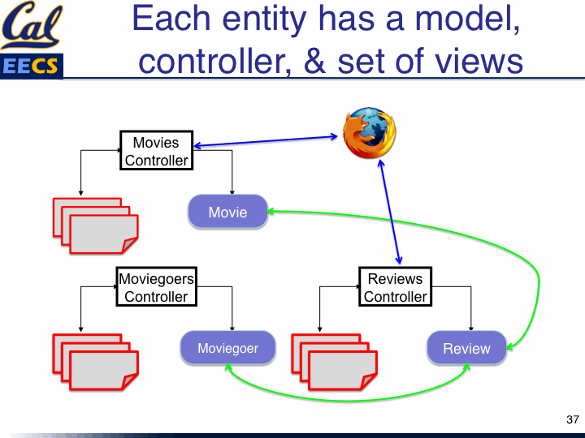
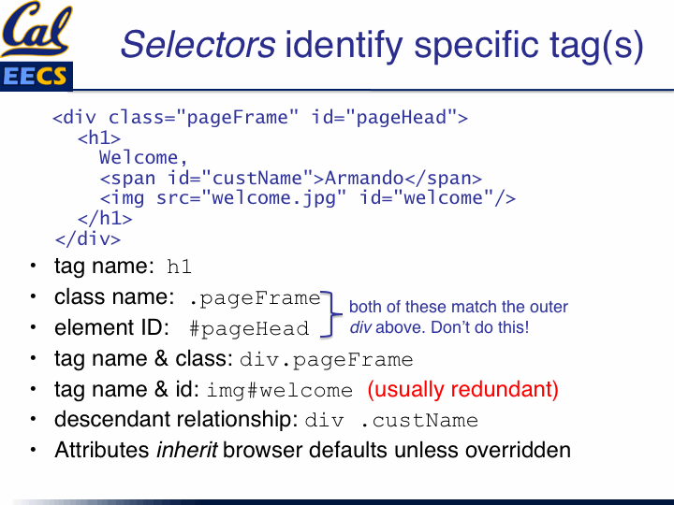
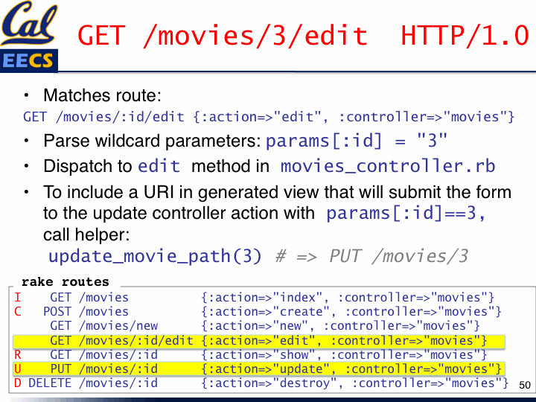
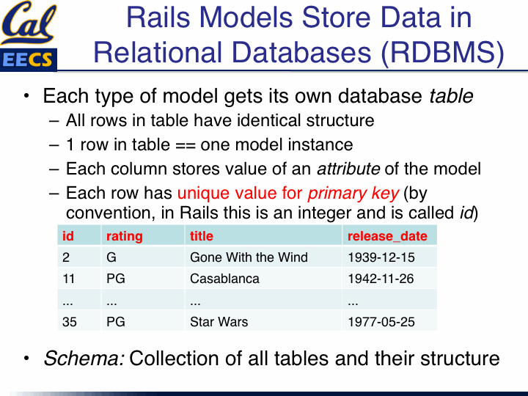
Connecting Arch. Concepts to Rails Apps
Gemfile
Rakefile
app | /models/, views/, controllers/
 | /helpers
 | /assets/stylesheets/application.css
config | /routes.rb
 | /database.yml
db | /development.sqlite3, test.sqlite3
 | /migrate/
log | /development.log, test.log
Notes:
Gemfile: which libraries does app depend on, so can ensure same versions installed in production. Gem is a Ruby library file.
Rakefile: you've already used 'rake routes' in book and lecture examples. Rake is Ruby make.

Slide 51

Rails as an MVC Framework
Model, View, Controller
Relational Database
Persistence: mysql or
sqlite3
tables
Subclasses of ActiveRecord::Base, an object-relational mapping layer
models/*.rb
your app
Logic: your code &
Rack appserver
views/*.html.haml
controllers/*.rb
Rails rendering
Rails routing
Presentation: WEBrick,
Apache, etc.
Subclasses of ActionView
Subclasses of ApplicationController
Client: Firefox

Slide 52
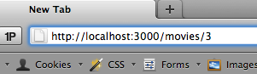
A Trip Through a Rails App
Routes (in routes.rb) map incoming URL’s to controller actions and extract any optional parameters
Route’s “wildcard” parameters (eg :id), plus any stuff after “?” in URL, are put into params[] hash accessible in controller actions
Controller actions set instance variables, visible to views
Subdirs and filenames of views/ match controllers & action names
Controller action eventually renders a view
app/controllers/movies_controller.rb
app/views/movies/show.html.haml
def show id = params[:id] @mv=Movie.find(id) end
%li Rating: = @mv.rating
config/routes.rb
GET /movies/:id {:action=>'show',:controller=>'movies'}

Slide 53
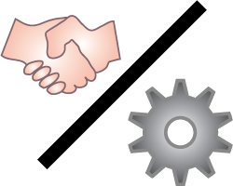
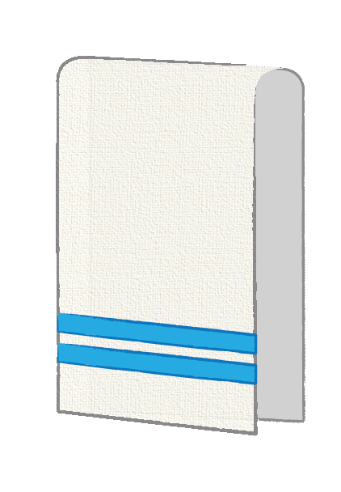
Rails Philosophy
Convention over configuration
If naming follows certain conventions, no need for config files
MoviesController#show in movies_controller.rb ➔ views/movies/show.html.haml
Don’t Repeat Yourself (DRY)
mechanisms to extract common functionality
Both rely heavily on Ruby features:
introspection and metaprogramming
blocks (closures)
modules (mix-ins)

Slide 54
END

Slide 55
Why must every interaction with a SaaS app eventually cause something to be rendered?
☐
Because of convention over configuration
☐
Because HTTP is a request-reply protocol
Because Model-View-Controller implies that every action renders its own View
☐
☐
All of the above
Notes:
False. Not in general.
True.
False. Two views could be called by same action.
False.

Slide 56
END

